Slide 1
Continuous
Random Variables

Slide 2
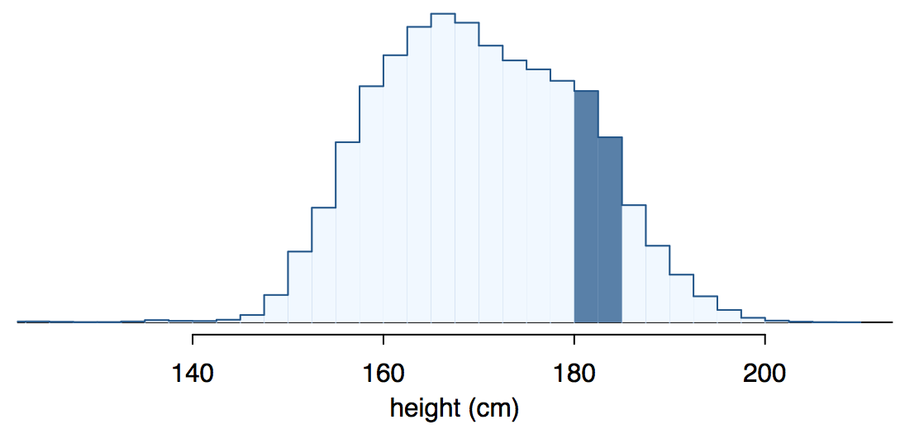
Continuous random variables
Below is a histogram of the distribution of heights of US adults.
The proportion of data that falls in the shaded bins gives the probability that a randomly sampled US adult is between 180 cm and 185 cm.

Slide 3
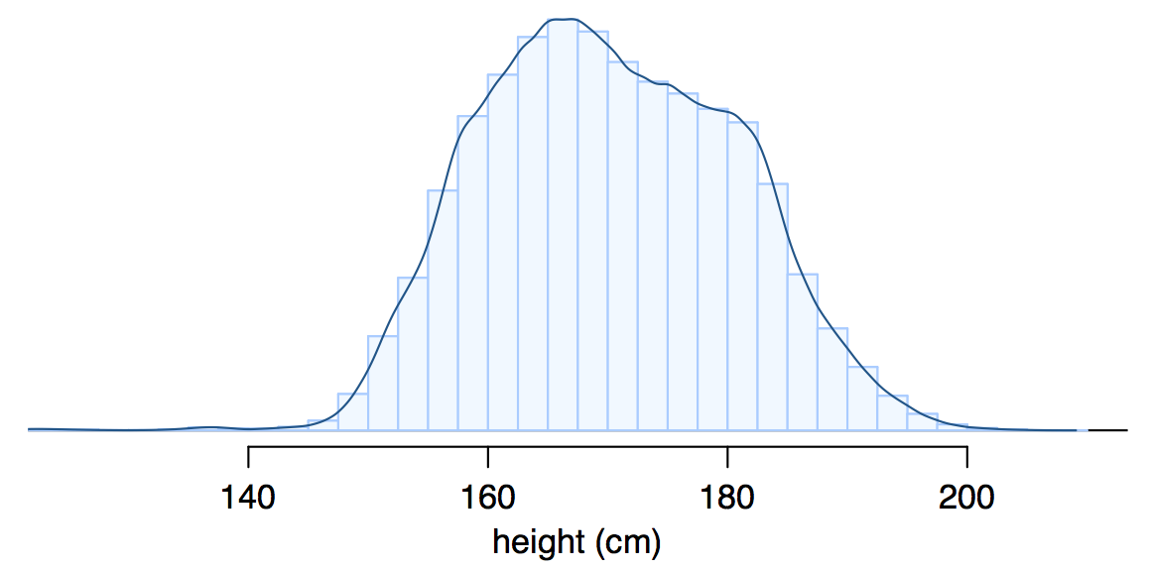
From histograms
to continuous distributions
Since height is a continuous numerical variable, we can reduce the width of the bins, until we obtain a smooth curve representing the probability density function (pdf) of the height.

Slide 4
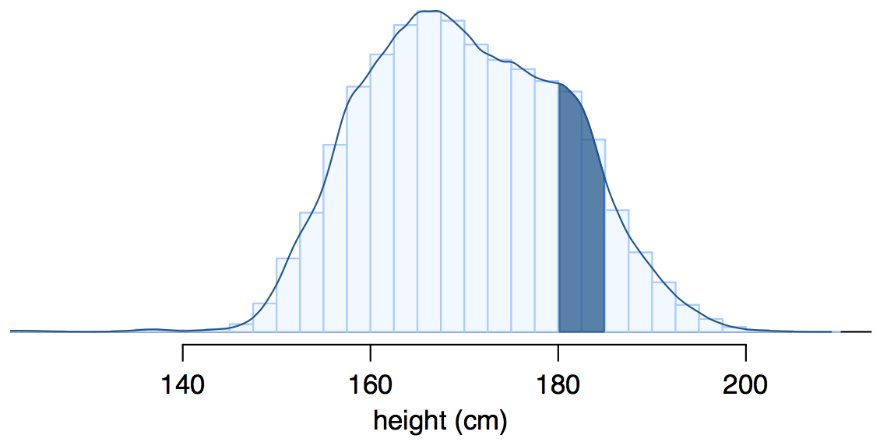
Probabilities from
probability density functions
Therefore, the probability that a randomly sampled US adult is between 180 cm and 185 cm is better estimated as the shaded area under the curve.

Slide 5
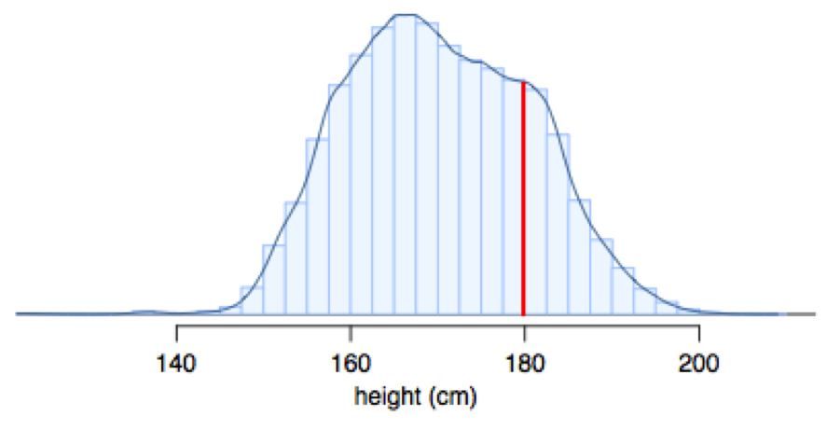
Probability density function
The pdf is a function f(X): R → [0,+∞] that describes the probability distribution of X.
P(a<X<b) can be computed as the area under f(X) between a and b.
The total area under f(X) is 1 (normalization constraint)
P(X=a) = 0
P(X≤a) = P(X<a)

Slide 6
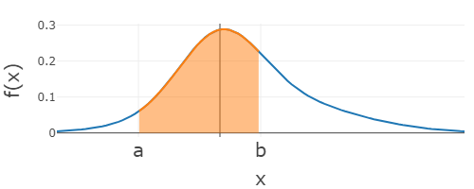
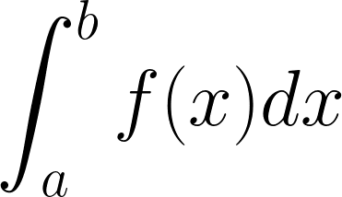
Areas and integrals
In general, the area under the curve described by function f(x) can be computed as an integral.
If f(x)≥0 for all x∈R, it corresponds to the area delimited by f(x), the x axis and the vertical lines x = a and x = b.

Slide 7
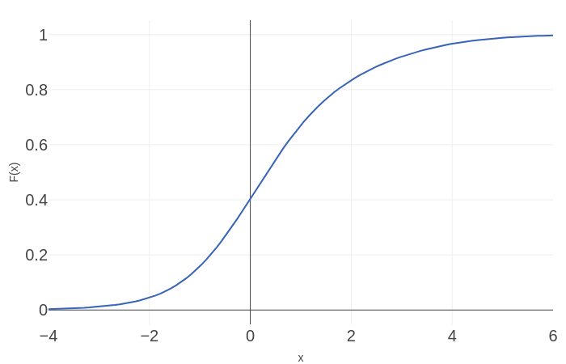
Cumulative distribution functions
The cumulative distribution function (cdf), usually named with an uppercase letter, e.g., F(x), is a function F(x): R→ [0,1] which associates to each x its cumulative probability P(X≤x).
F(x) is a non decreasing function
F(-∞) = 0, F(+∞)=1

Slide 8
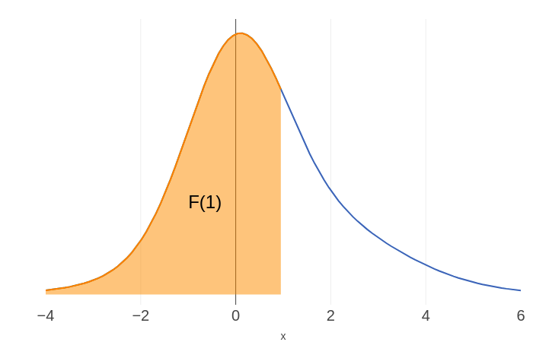
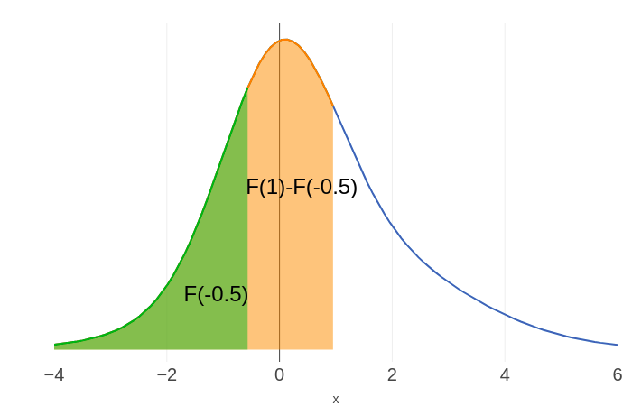
Cumulative distribution functions
The cumulative distribution function (cdf), usually named with an uppercase letter, e.g., F(x), is a function F(x): R→ [0,1] which associates to each x its cumulative probability P(X≤x).
F(x) is a non decreasing function
F(-∞) = 0, F(+∞)=1
F(x) correspond to the area under the pdf from -∞ to x
P(a<X≤b) = F(b)-F(a)

Slide 9
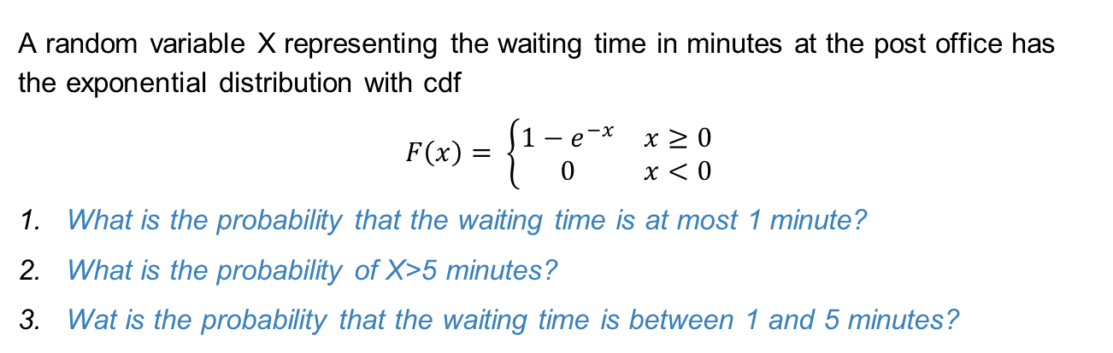
Example
A random variable X representing the waiting time in minutes at the post office has the exponential distribution with cdf
$$F\left(x\right)= \left\{\begin{matrix}1−ⅇ^{−x} & x≥0 \\ 0 & x<0\end{matrix}\right.$$
What is the probability that the waiting time is at most 1 minute?
What is the probability of X>5 minutes?
Wat is the probability that the waiting time is between 1 and 5 minutes?

Slide 10
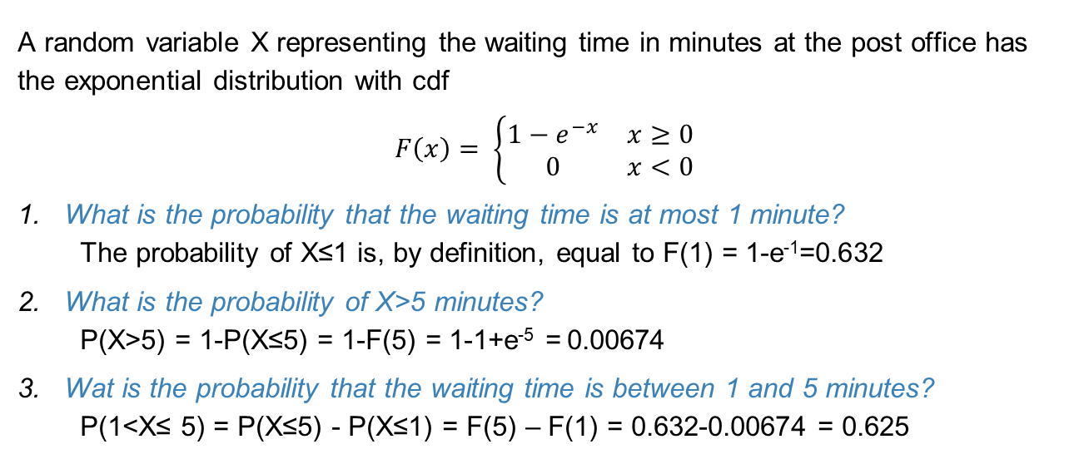
Example
A random variable X representing the waiting time in minutes at the post office has the exponential distribution with cdf
$$F\left(x\right)= \left\{\begin{matrix}1−ⅇ^{−x} & x≥0 \\ 0 & x<0\end{matrix}\right.$$
What is the probability that the waiting time is at most 1 minute?
The probability of X≤1 is, by definition, equal to F(1) = 1-e⁻¹=0.632
What is the probability of X>5 minutes?
P(X>5) = 1-P(X≤5) = 1-F(5) = 1-1+e⁻⁵ = 0.00674
Wat is the probability that the waiting time is between 1 and 5 minutes?
P(1<X≤ 5) = P(X≤5) - P(X≤1) = F(5) – F(1) = 0.632-0.00674 = 0.625

Slide 11
Uniform distribution
What are the pdf and the cdf of a random variable X uniformly distributed between a and b?

Slide 12
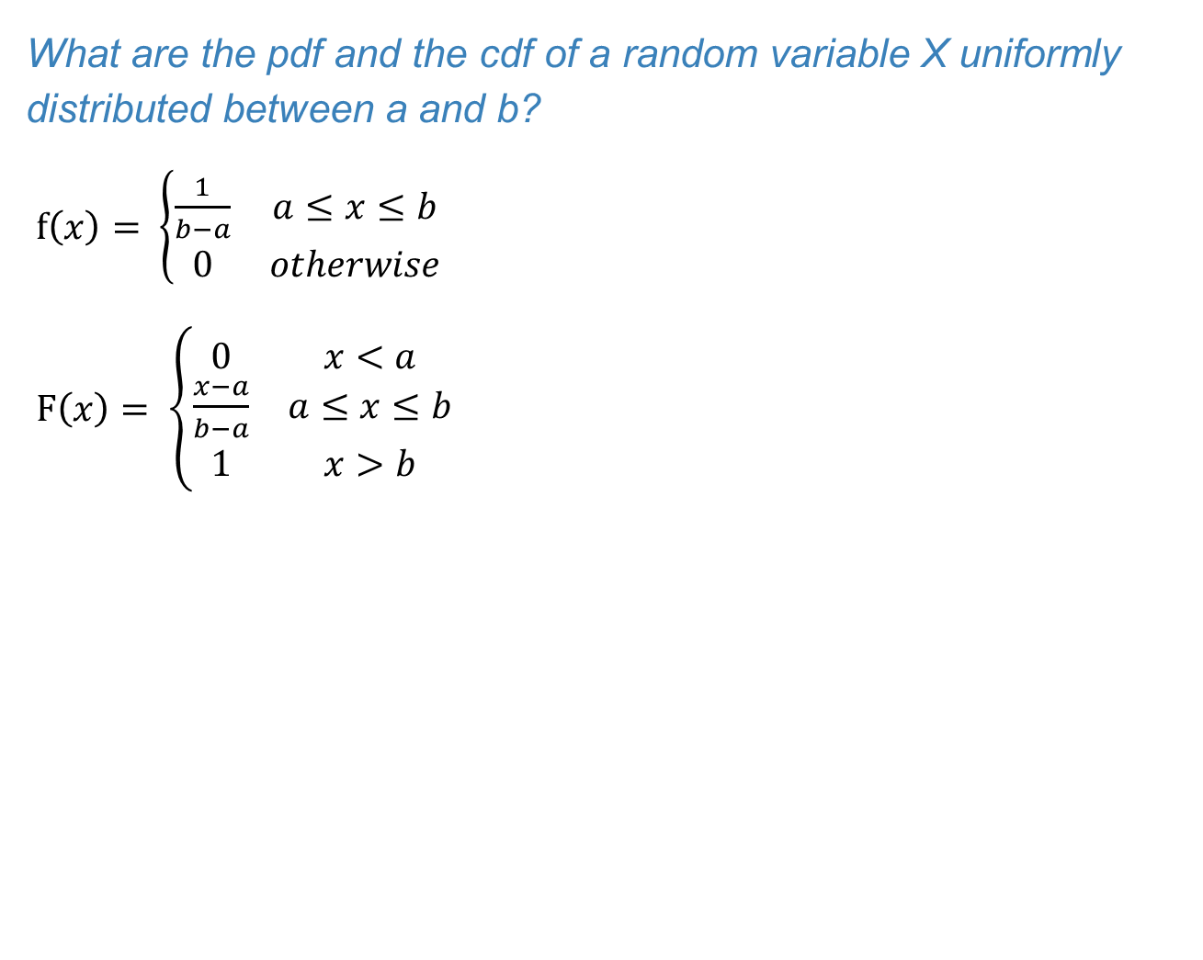
Uniform distribution
What are the pdf and the cdf of a random variable X uniformly distributed between a and b?
$f\left(x\right)= \left\{\begin{matrix}\frac{1}{b−a} & a≤x≤b \\ 0 & otherwise\end{matrix}\right.$
$F\left(x\right)= \left\{\begin{matrix}0 & x<a \\ \frac{x−a}{b−a} & a≤x≤b \\ 1 & x>b\end{matrix}\right.$
f(x)
1/(b-a)
Total area=1
F(x)
1-F(x)
a
x
b
F(x)
1
a
x
b

Slide 13
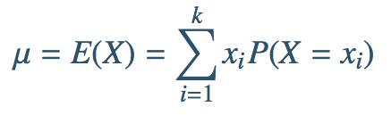
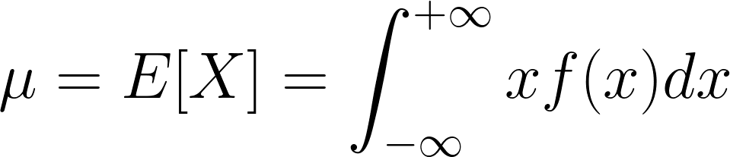
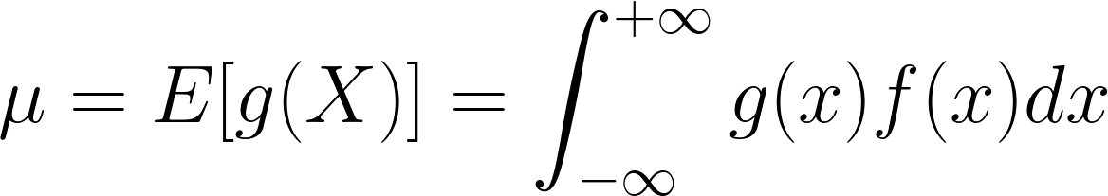
Expected value of a continuous rv
For a discrete rv we have
For a continuous rv, the summation becomes an integral:
Analogously, the expected value of a function g(X) of X is

Slide 14
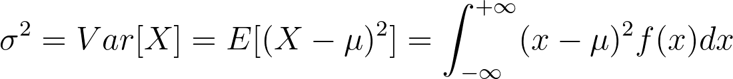
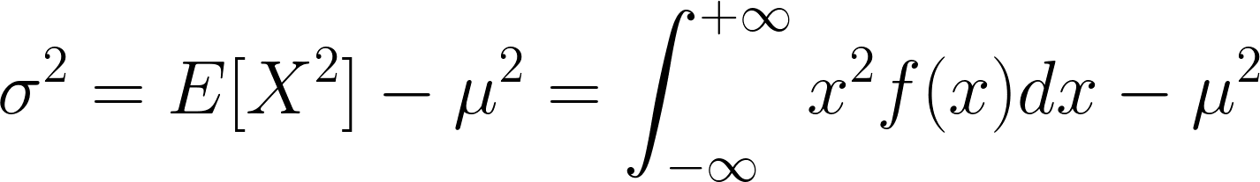

Variance of a continuous rv
The variance of a continuous rv is:
It also holds
The standard deviation is still

Slide 15



Expected value and variance of the uniform distribution
E[X] = (a+b)/2
Var[X] = (b-a)²/12
$σ =(b−a)/\sqrt{12}$
1/(b-a)
$$σ$$
$$σ$$
a
µ
b

